Slide 1
Health Insurance
Market Study
A Study of Adverse Selection in the Health Insurance Market
Project focus: Health insurance choices and premium sensitivity
Areas of study: Insurance ownership, plan preferences, affordability and consumer behaviour
Tools used: Python and Jupyter Notebook
Review presentation: Data Analysis, Results and Key Findings
Notes:
Slide 1: Introduction
“Good morning. My project studies the health insurance market, focusing on adverse selection. Analysing insurance ownership, plan preferences, premium sensitivity and consumer behaviour using Python.”

Slide 2
Objectives of the Study
1
Study health insurance ownership across age groups.
2
Identify factors influencing insurance plan selection.
3
Understand consumer responses to premium increases.
4
Examine the relationship between affordability and plan preferences.
5
Explain adverse selection and its importance in insurance markets.
6
Use Python to clean, analyse and present data.
02
Notes:
Slide 2: Objectives
“My objectives are to compare insurance ownership across age groups, identify factors affecting plan selection, study responses to premium increases, and understand adverse selection.”

Slide 3

Data and Methodology
Data used
Analysis process
Sample dataset: 30 records
Data format: CSV
Variables: Age group, insurance ownership, preferred plan, decision factor, premium response and affordability range
Data type: Mainly categorical data
Load the CSV file into Jupyter Notebook.
Inspect the data and check missing values.
Check categories and data consistency.
Calculate frequencies and percentages.
Compare results using tables and charts.
03
Notes:
Slide 3: Data and Methodology
“I use a CSV dataset containing 30 sample records with categorical data. My methodology includes data collection, data cleaning, exploratory data analysis, and presenting results through tables and charts using visualisation tool in python.”

Slide 4
Data Cleaning and Preparation
Steps performed
Code :
Imported the CSV using Pandas.
Checked the number of rows and columns.
Inspected column names and data types.
Checked for missing values.
Checked for duplicate records.
Reviewed category consistency before analysis.
import pandas as pd
df = pd.read_csv("health_insurance.csv")
print("Dataset shape:", df.shape)
print(df.info())
print("Missing values:")
print(df.isnull().sum())
print("Duplicate rows:", df.duplicated().sum())
display(df.head())
Python tools: Pandas, Jupyter Notebook
04
Notes:
Slide 4: Data Cleaning
“I used Pandas in Jupyter Notebook to load and inspect the dataset. Check missing values, duplicate records, data types and consistency before analysis.”

Slide 5
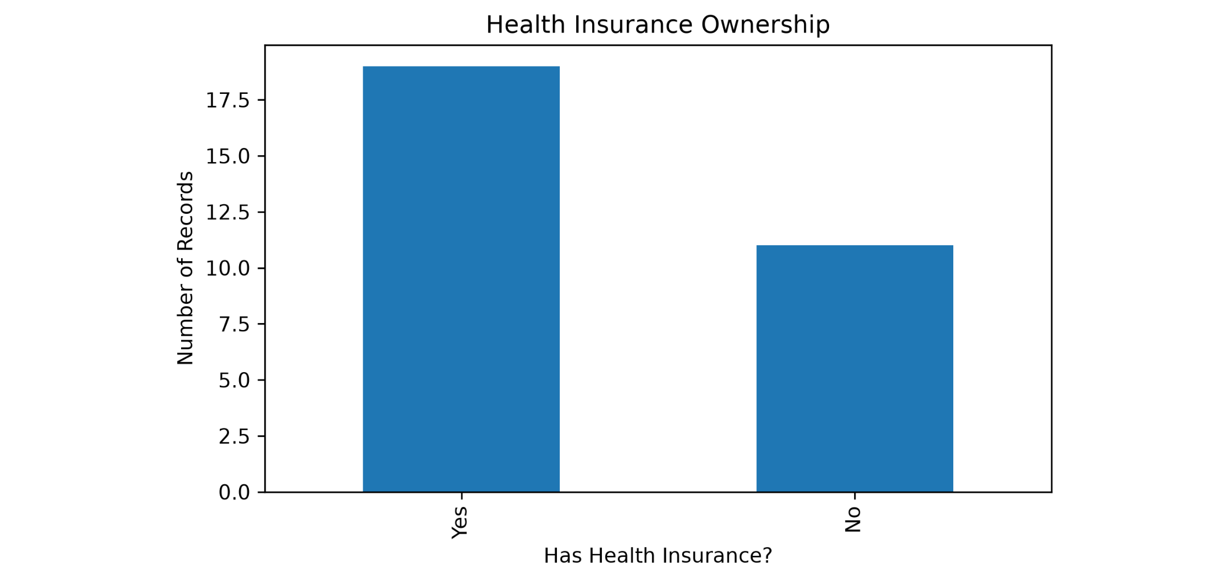
Health Insurance Ownership in the Sample
19 — Have insurance
63.3%
11 — Do not have insurance
36.7%
Sample size: 30 records
Interpretation: In this sample, more records indicate insurance ownership than non-ownership.
05
Notes:
Slide 5: Insurance Ownership
“In the sample, 19 records indicate insurance ownership and 11 indicate no insurance. That is 63.3% and 36.7%, respectively.”

Slide 6
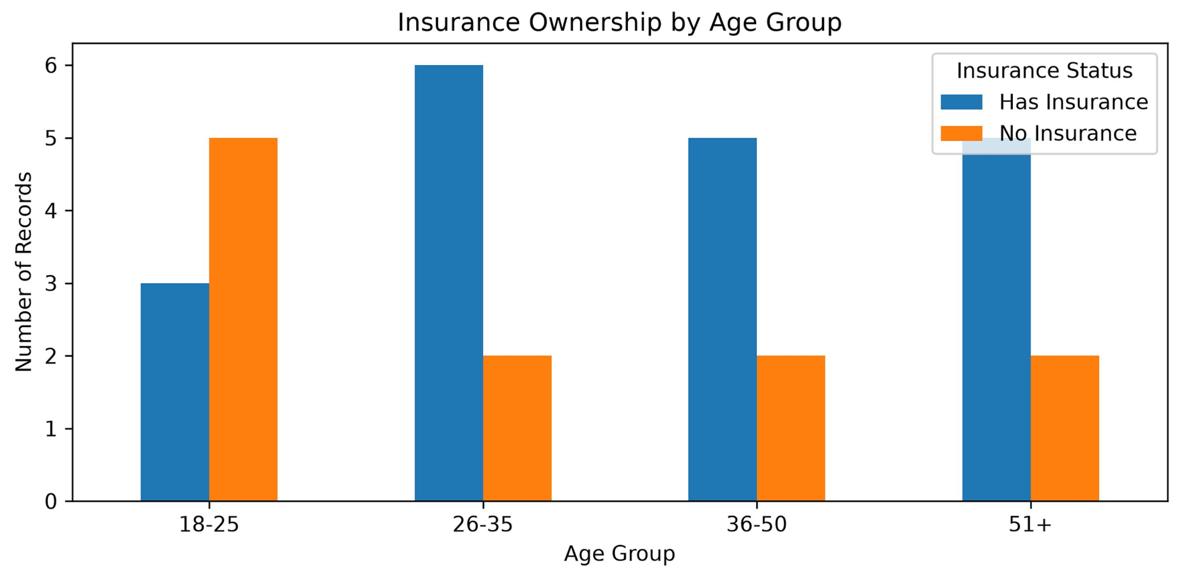
Insurance Ownership Across Age Groups
Observation
The 18–25 age group has fewer insured records in this sample.
The 26–35 age group has the highest number of insured records.
Age-group differences in this small sample require cautious interpretation.
06
Notes:
Slide 6: Ownership by Age Group
“The sample shows differences in insurance ownership across age groups. The 26–35 group has the highest number of insured records.”

Slide 7
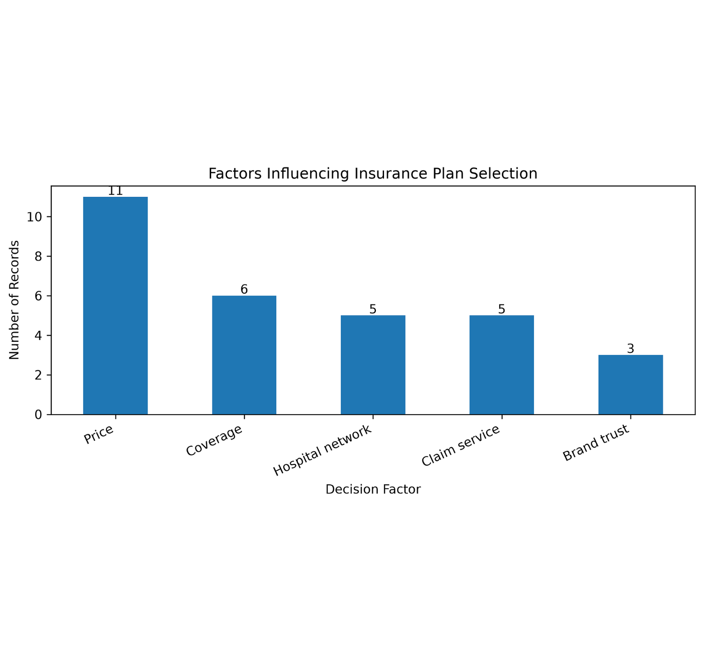
What Influences Insurance Choices?
Preferred plans
Basic: 9 records
Standard: 9 records
Comprehensive: 8 records
Unsure: 4 records
Main decision factors
Price: 11 records
Coverage: 6 records
Hospital network: 5 records
Claim service: 5 records
Brand trust: 3 records
07
Notes:
Slide 7: Plan Preferences
“Basic and Standard plans are the most frequently preferred categories. Price is the leading decision factor, followed by coverage. This demonstrates how affordability may influence plan selection in the sample.”

Slide 8
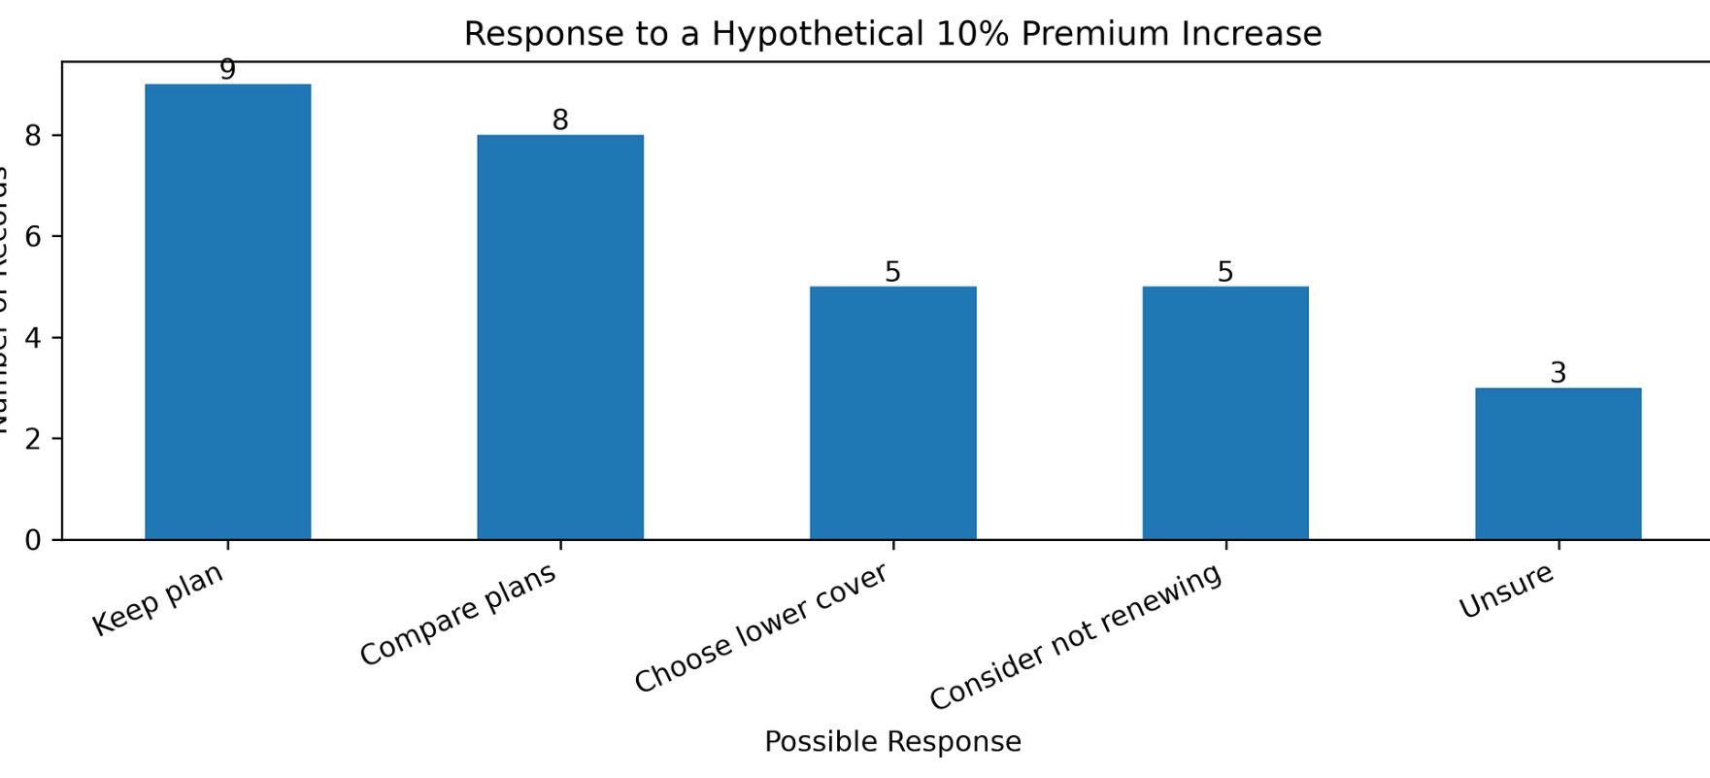
What If Premiums Increase by 10%?
Responses to a hypothetical situation
Key observation
Comparing plans is a common response to a premium increase.
Some sample records indicate a possible move to lower coverage or non-renewal.
These are hypothetical responses, not observed purchasing behaviour.
08
Notes:
Slide 8: Premium Increase
“When asked about a hypothetical 10% premium increase, some records indicate that people would compare plans, choose lower coverage or consider non-renewal. This illustrates premium sensitivity, not actual behaviour.”

Slide 9
Key Findings and Economic Interpretation
Findings from the sample
Economic concept: Adverse selection
Insurance ownership differs across the age groups in the sample.
Price is the most frequently selected decision factor.
Some records indicate possible changes in coverage or renewal decisions after a premium increase.
Adverse selection occurs when people with higher expected healthcare costs are more likely to buy or retain insurance than people with lower expected costs.
This can increase the average risk of the insured group and put pressure on premiums.
Limitation: This dataset does not contain individual health-risk or claims information, so it cannot prove adverse selection.
09
Notes:
Slide 9: Key Findings and Adverse Selection
“The analysis suggests that affordability can influence insurance decisions, and a premium increase may encourage some consumers to compare plans or reduce coverage. Adverse selection occurs when people with higher expected healthcare costs are more likely to seek insurance, potentially increasing the average risk of the insured group and putting upward pressure on premiums. This highlights the importance of balanced risk pooling.”

Slide 10

Recommendations and Conclusion
Recommendations
Limitations
Explain policy coverage, exclusions and premiums clearly.
Offer suitable plan options for different budgets.
Make claim procedures and hospital networks easier to understand.
Study real enrolment, risk and claims data to investigate adverse selection.
The analysis uses 30 sample-generated records.
The dataset does not contain actual policy prices, health risks or claims.
Conclusion
Python can help organise insurance data and identify patterns. Reliable conclusions about the real insurance market require genuine, representative data.
Data: project demo CSV.
Concepts: IRDAI Handbook of Indian Insurance; Ministry of Health and Family Welfare, National Health Accounts of India.
10
Notes:
Slide 10: Recommendations and Conclusion
“Insurers should offer suitable plans for different budgets, explain coverage and exclusions clearly, and maintain an effective risk pool. They should also monitor enrolment patterns and claims data to identify adverse selection. To conclude, understanding consumer behaviour, premium sensitivity and risk pooling can help insurers design sustainable and affordable health insurance products. Thank you.”

